Slide 1
Monthly Meeting
July 16, 2024

Slide 2
Agenda
Outperform and Outlast Rollout
Proposed Rule
Legislative Update
Outreach from GAO
Website Update
Mentor Protégé Summit 2024

Slide 3
Outperform and Outlast Rollout
NCEO Blog Post & report on website
Press release sent to ECR Members
Press release posted by ECR and ESCA
Press release sent to other ESOP organizations
Emails to Congressional supporters
Emails to Agency supporters
Interviews: Targeting Federal News Network and Washington Technology
Speaking opportunities at conferences (TBD)

Slide 4
Proposed Rule
Other Public Comments as of July 16 – Total 10
Proposed Rule One-pager Now Available
Draft ECR Comments Content – Informative and Supportive
  Description of ECR & Benefits of Employee Ownership
  Proposed Rule Inputs
    Commends rulemaking effort - authority for DoD contracting officers as well as those contracting on behalf of DoD (e.g. GSA)
    Supports creation of new Part 270 and application to commercial products and commercial services
    Supports data collection to assess effectiveness
    Supports requirement for a J&A
  Add individual company logos
Other inputs – no limit on length, but stay supportive and germane
Will send email to confirm inclusion of logo

Slide 5
Legislative Update
FY25 NDAA SASC Report – Item of Special Interest
Employee-owned business contracting pilot program
The committee is aware that the Department of Defense recently issued a proposed rule to the Defense Federal Acquisition Regulations Supplement (DFARS) to fully implement the pilot program that was established by section 874 of the National Defense Authorization Act for Fiscal Year 2022 (Public Law 117-81), and extended by section 872 of the National Defense Authorization Act for Fiscal Year 2024 (Public Law 118-31), to incentivize contracting with employee-owned businesses. The committee notes that the pilot program was extended to ensure the Department has an opportunity to gather sufficient data so that the pilot program can be thoroughly evaluated. The committee looks forward to monitoring the pilot program and encourages the Department to quickly complete the rulemaking process.

Slide 6
Legislative Update (cont.)
FY25 NDAA HASC Report – Direct Report Language
Implementation of Department of Defense Employee Stock Ownership Program
The committee recognizes the innovative potential created by incentivizing businesses organized as private subchapter S corporations wholly owned through an employee stock ownership plan (ESOP) to provide products and services for the Department of Defense.
Therefore, the committee encourages the Department to accelerate implementation of the pilot program established by section 874 of the National Defense Authorization Act for Fiscal Year 2022 (Public Law 117-81) and include the improvements by section 872 of the National Defense Authorization Act for Fiscal Year 2024 (Public Law 118-31) in any prescribed regulations.
The committee directs the Under Secretary of Defense for Acquisition and Sustainment to provide a briefing to the House Committee on Armed Services by December 1, 2024, on progress made to:
(1) prescribe regulations to implement the pilot;
(2) to gather lessons learned from it; and
(3) to consider whether other legislative changes, such as expanding the authority government wide, would continue growth in not only the number of businesses wholly-owned by an ESOP but also the total number of employee owners in the defense industrial base and federal contractors.

Slide 7
Legislative Update (cont.)
A Report accompanying each version of the committee’s NDAA is voted out of committee with the legislative (or bill) text.
The Report contains sections called direct report language and items of special interest.
Only legislative (or bill) text will be conferenced.
The HASC direct report language and the SASC Item of Special Interest will not be conferenced and stand as written.
Goal of this year’s ask was to accelerate rulemaking.

Slide 8
Outreach from GAO
GAO has begun outreach to companies who have use Sec. 874 authority to “discuss your experience as a participant in the pilot program and your experience in becoming an ESOP.”
ECR is developing a white paper to assist with interactions.
If you have been contacted by GAO, please let us know.

Slide 9
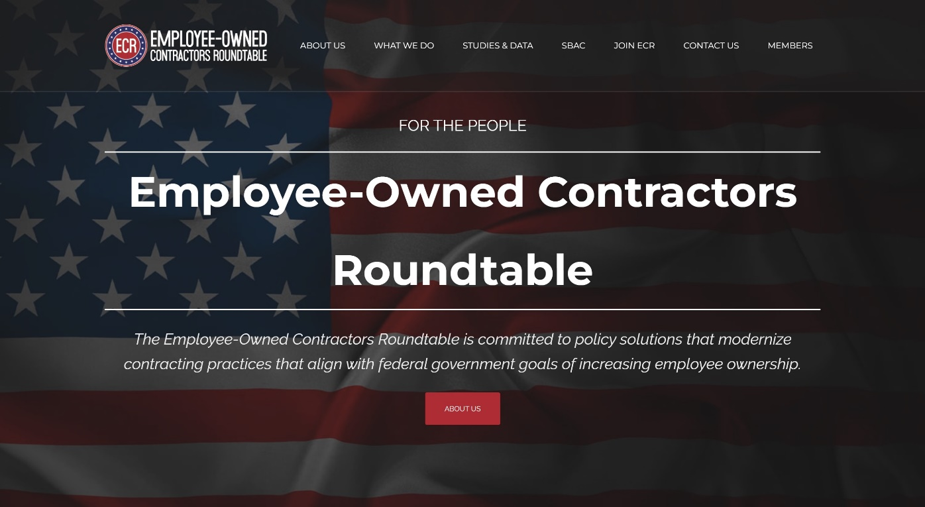
Website Update
Check out new updates at ecrcoalition.com
Study posted and press release coming soon
General updates

Slide 10
Mentor Protégé Summit 2024
Mentor Protégé Program Summit 2024
July 29 – August 1 in Detroit, Michigan
  SBIR / STTR, Innovation Hubs (e.g. AFWERX), Category Management, CMMC, APEX (formerly PTACs), 8(a) certifications.
Networking - 1:1 pre-scheduled speed networking meetings based on the requirements of the individual companies.
Opportunity to highlight benefits of employee ownership.
Please let us know if attending.
Targeting this event for 2025 strategic outreach.

Slide 11
Discussion
(Monthly Meetings on last Tuesday of each month at 4:00 pm ET)

