Slide 1
Monthly Meeting September 24, 2024

Slide 2
Agenda
New Members
GAO Report Support
Networking Event
LinkedIn Page
Agency Strategic Engagement
Rule Making Status
Legislative Update
December 2024 Strategic Planning & ECR Summit

Slide 3
New Members
Bryan Construction
Concept-to-completion construction for multiple federal agencies, including the U.S. Army Corps of Engineers, the Department of Defense, the Coast Guard, the Navy, General Services Administration, and the National Guard
POC: Brian Burns, President, bburns@bryanconstruction.com
Howell Laboratories
Engineers, manufactures, and tests fluid processing equipment for military and commercial applications
POC: Joseph McDonnell, President & CEO, jmcdonnell@howelllabs.com
Tecolote Research
Consulting, analytics, and digital solutions to senior leadership and Federal government executives supporting the National Security mission
POC: Jim Takayesu, President & CEO, jtakayesu@tecolote.com
Weston Solutions
Consulting, planning, engineering, construction, and O&M solutions for complex environmental and infrastructure challenges
POC: Matthew Beatty, Senior Vice President, Chief Strategy and Development Officer, M.Beatty@WestonSolutions.com
Indus Technology
Government services provider with expertise in Engineering, Information Technology, Cybersecurity, Program/Financial Management, Logistics, and Data Analytics
POC: Eric MacGregor, President & CEO, EMacGregor@industechnology.com

Slide 4
GAO Report Support
Outperform and Outlast – 100% Employee-Owned Contractors Top the Charts
Employee Ownership, ESOPs, Wealth, and Wages
S Corporation ESOPs – Advantages in an Uncertain Economy
Contribution of S ESOPs to Participant Retirement Security and Employee-Owner Benefits
Link to a table comparing the four major approaches to employee ownership: Employee Ownership for Closely Held (Private) Companies: ESOPs, Equity Grants, Trusts, and Worker Cooperatives | NCEO
Link to academic center on employee ownership: Rutgers Institute for the Study of Employee Ownership and Profit Sharing
Link to another academic center on employee ownership: UC San Diego’s Beyster Institute for Employee Ownership

Slide 5
Networking Event
Attendees: 16
Agenda
Overview of ECR
2023 – Year in Review
2024 – Year to Date
Rulemaking
Outperform and Outlast
Benefits of ECR (Dave Cook and Barry Page)
December – 2025 Strategic Planning and ECR Symposium
2025 – Look Ahead

Slide 6
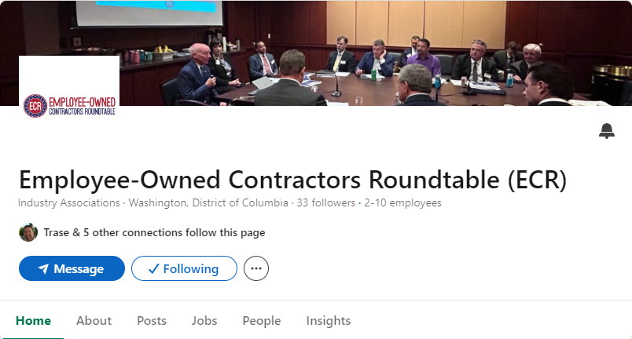
LinkedIn Page
Check out (and Follow) new ECR LinkedIn Page
https://www.linkedin.com/company/employee-owned-contractors-roundtable-ecr/
Outperform and Outlast – first posts
NCEO blog
Interview with Tom Temin

Slide 7
Agency Strategic Engagement
CY24 Agency Strategic Engagement Goal is Building Champions
CY24 Agency Strategic Engagement Plan is a living document; items in bold are confirmed and/or already accomplished, items italicize are currently being scheduling.
AFMC – Air Force Materiel Command
DHS – Department of Homeland Security
DLA – Defense Logistics Agency
GSA – General Services Administration
NDIA – National Defense Industrial Association
PSC – Professional Services Council
SBA – Small Business Administration
SECAF – Small and Emerging Contractors Advisory Forum
USAID – US Agency for International Development

Slide 8
Rulemaking Update: Sec. 874 / Sec. 872
DFARS Case 2024 – D004 implementing Sec. 874 with Sec. 872 improvements initiated in January 2024
Current update via DoD’s DFARS Open Cases
09/11/2024 Case manager forwarded draft final DFARS rule to DARS Regulatory Control Officer. DARS Regulatory Control Officer reviewing.
Expect DFARS rule making to be completed January 2025
DFARS Operating Guide:
https://www.acq.osd.mil/dpap/dars/docs/far_dfars_guide/DFARS_Operating_Guide_January_2015.pdf
DFARS Open Cases:
https://www.acq.osd.mil/dpap/dars/opencases/dfarscasenum/dfars.pdf

Slide 9
DFARS Case 2024 – D004
 | Step | Weeks |  | Actual
Proposed Rule Making (24 weeks) | Submit Report | 7 | Start ~ 1/24/24
 | DARC agrees to rule | 2 | 3/13/24 | 03/06/2024 Case manager forwarded draft proposed rule to DARS Regulatory Control Officer. DARS Regulatory Control Officer reviewing.” 04/16/2024 DARS Regulatory Control Officer identified issues with draft proposed rule to case manager. Case manager and DARS Regulatory Control Officer resolving issues.
 | Case Manager | 1 | 3/27/24
 | DoD Approval to Publish | 5.5 | 4/3/24
 | OFPP/OIRA identify issues | 2 | 5/15/24
 | Resolve OFPP/OIRA issues | 2 | 5/29/24 | 05/02/2024 OIRA cleared proposed DFARS rule. DARS Regulatory Control Officer preparing for publication, pending DoD ATP.
 | Publish proposed rule | 4.5 | 6/12/24
Public Comment (60 days) | Public Comment (60 days) | 9 | 7/10/24 | 5/29/2024 Proposed rule published
Final Rule Making (19 weeks) | Submit Report | 4 | 9/11/24 | 09/11/2024 Case manager forwarded draft final DFARS rule to DARS Regulatory Control Officer. DARS Regulatory Control Officer reviewing.
 | DARC agrees to rule | 2 | 10/9/24
 | Case Manager | 1 | 10/23/24
 | DoD Approval to Publish | 5.5 | 12/4/24
 | OFPP/OIRA identify issues | 1 | 12/11/24
 | Resolve OFPP/OIRA issues | 1 | 12/18/24
 | Publish final rule | 4.5 | 1/22/25
DFARS Operating Guide:
https://www.acq.osd.mil/dpap/dars/docs/far_dfars_guide/DFARS_Operating_Guide_January_2015.pdf
DFARS Open Cases:
https://www.acq.osd.mil/dpap/dars/opencases/dfarscasenum/dfars.pdf

Slide 10
Legislative Update
This week, Congress is working through a continuing resolution to fund the government through mid-December, likely teeing up an omnibus spending and policy bill at the end of the year.
NDAA may be used as a vehicle to move spending or policy priorities, slowing NDAA’s timeline of coming up for a final vote.
Senate Armed Services continued their work on NDAA last week and released the managers package for their version of NDAA.
House and Senate negotiators will craft the final version of the bill over the coming weeks, leading to final passage after elections.

Slide 11
2025 Strategic Planning
What: 2025 Strategic Planning
When: Tuesday, December 10, 2 pm – 5 pm, Dinner to Follow
Where: Washington DC – Venn Strategies
ECR Summit next day

Slide 12
ECR Summit
What: Discuss policy solutions to modernize contracting practices that align with increasing employee ownership.
When: Wednesday, December 11
Where: Capitol Hill – Washington DC
Agenda:
Political Update and Outlook
Policy Discussions
Congressional Member Conversations
Networking

Slide 13
Discussion (Monthly Meetings on last Tuesday of each month at 4:00 pm ET)

