Slide 1
Monthly Meeting
July 29, 2025

Slide 2
Agenda
NDAA Update
Hill Day Recap
Executive Council Strategy Session Readout
LinkedIn Posts
DFARS Subpart 270.1 Updates
Agency Strategic Engagement
Website Updates
EC Strategy Session Survey
Scheduling Update

Slide 3
NDAA Update
"GSA fix' included in the House Chairman's Mark which
  Commends DPC’s rulemaking and implementation
  Emphasizes that the pilot program is intended to be used by both DoD and other agency contracting officers (e.g., GSA) acting on behalf of DoD customers
  Recognizes the GAO report and DPC’s early steps to improve implementation
  Requires a briefing by DPC on how they are fully leveraging the authority
Conference process will start after August recess

Slide 4
Hill Day Recap
Nearly two dozen ECR members participated in our advocacy day, which included meetings with offices for key committees.
Importantly, we met with several new offices as a result of our expanded membership footprint, helping to establish potential new champions.
Participated in political giving event for Rep. Turner
  Targeted for his roles on HASC & Oversight committees, as well as the volume of ECR members in his district, he is uniquely situated to help us on gov’t-wide duplication.

Slide 5
Hill Day Recap
House Oversight & Government Reform (HOGR) Members
Rep. Jack (R-GA)
Rep. Frost (D-FL)
Rep. Perry (R-PA)
Rep. Gill (R-TX)
Rep. Subramanyam (R-VA)
Senate Homeland Security & Government Affairs (HSGAC) Members
Sen. Hawley (R-MO)
Sen. Scott (R-FL)
Sen. Moody (R-FL)
Sen. Peters (D-MI)
Sen. Slotkin (D-MI)
Sen. Gallego (D-AZ)
Sen. Kim (D-NJ) HSGAC staff
House Small Business Members
Rep. Jack (R-GA)
Rep. Olszewski (D-MD)
Rep. Scholten (D-MI)
Senate Small Business
Sen. Markey (D-MA) SSBC staff
Sen. Hawley (R-MO)
Sen. Husted (R-OH)
Sen. Hickenlooper (D-CO)

Slide 6
Hill Day Recap
Takeaways & Next Steps
  Both government-wide duplication and maintaining special designations for partial ESOPs transitioning to 100% were positively received
  We are scheduling some virtual follow up meetings with offices throughout August to keep staff engaged on our issues
  We are working through options for potential end of year activity on government-wide duplication to ensure we don't miss any opportunities and are well situated for FY 27 NDAA

Slide 7
Executive Council Strategy Session Readout
Expanded social media
  Increase LinkedIn posting to expand network, ~2 per month
  News flash for ECR friends & allies, ~6 per year
New studies
  Retention rates at 100% S Corp ESOP contractors
  Creation of 100% S Corp ESOPs as a result of the pilot program
ECR Looking Forward: 2025
  Q3 2026 Executive Council strategy session
  Annual Summit on Driving Policy Change for ESOPs

Slide 8
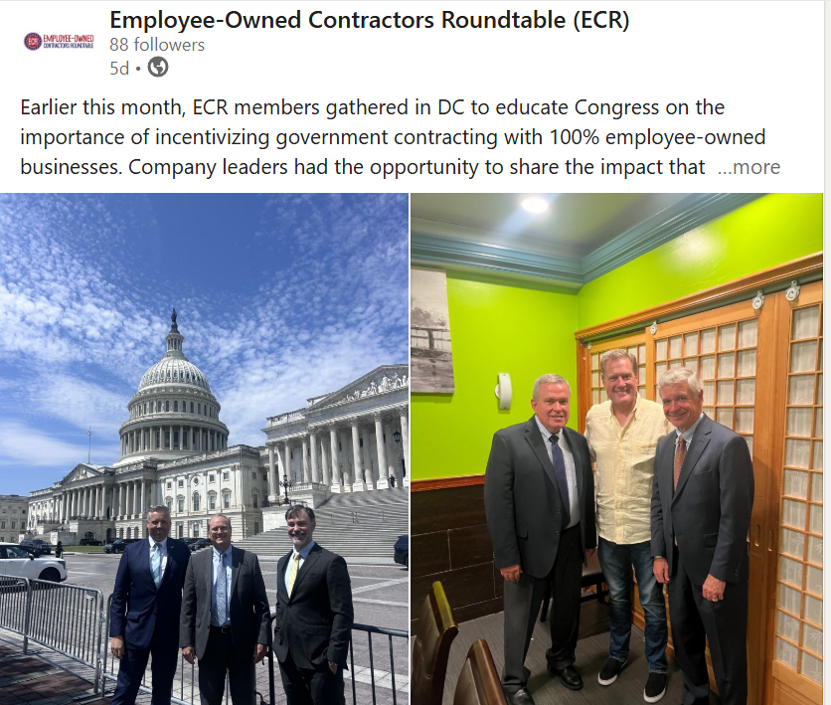
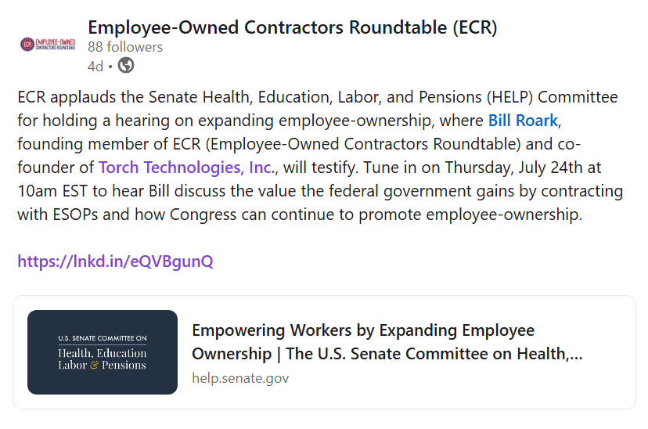
LinkedIn Posts
587 Impressions, 2 new followers
https://www.linkedin.com/company/employee-owned-contractors-roundtable-ecr

Slide 9
DFARS Subpart 270.1 Updates
New DPC FAQ dated July 11, 2025: https://www.acq.osd.mil/dpap/policy/policyvault/USA002576-24-DPCAP.pdf
  Does not include GSA fix
  Addresses required compliance with EOs and DoD policies on review of services contracts
  Adds to what constitutes (and what does not constitute) substantially similar
  Provides example of how to calculate the 50% subcontracting rule

Slide 10
DFARS Subpart 270.1 Updates
DFARS Subpart 270.1 Use
  Applications Submitted Yes (~6) – these have been the same for a while…
  DPC Approving Yes (3)
  Contract Awards Not aware of any yet
  Organizations USSF, USAF
ECR Member Companies Feedback
  Ensure contracting officer includes all required documentation in submission to DPC
  DPC review process taking 30 days
  DPC can handle classified applications – DPC recommends generic descriptions or redact the information
  DPC welcomes calls/emails for questions
  Updated ECR FAQ v11
Please fill out ECR's 270.1 Usage Tracking Survey: https://forms.cloud.microsoft/r/iMtNnNcbEG
Supporting Documents
DFARS Subpart 270.1:https://www.acquisition.gov/dfars/part-270-defense-contracting-programs
PGI: https://www.acquisition.gov/dfarspgi/pgi-part-270-defense-contracting-programs
Policy Memo: https://www.acq.osd.mil/dpap/policy/policyvault/USA002576-24-DPCAP.pdf
  Supporting Documents
  ECR FAQs: See monthly emails, website, or request directly
  ECR Sample J&A: See monthly emails, website, or request directly

Slide 11
DFARS Subpart 270.1 Usage Tracking
If you are at any stage of using 270.1 authority (i.e. just applying, have been approved or have been awarded a contract), please fill out ECR's 270.1 Usage Tracking Survey: https://forms.cloud.microsoft/r/iMtNnNcbEG
Thank you to MTSI, ASI, Weston Solutions, DSA, and Torch for completing the form.
The purpose of collecting this data is
  Help prove out effectiveness of DFARS Subpart 270.1
  Facilitate conversations between PCO’s to mitigate any uncertainty around usage of the pilot program

Slide 12
Agency Strategic Engagement
Army – DASA(P)
  July 11 – Briefed Army Head of Contracting Agency (HCAs)
  In scheduling: Will record a training video over Teams and then post to the Army website
Air Force - SAF/AQC Deputy (this individual was previously DPC deputy)
  Continuing dialogue – asked for list of 100% S Corp ESOPs
Navy – DASN(P)
  July 23 – Briefed DASN(P) Executive Director; emphasized making full use of the authority; DASN(P) confirmed full support of the pilot program
  Offered to brief at next Qtr mtg (Nov) and contracting officer events next year

Slide 13
Website Updates
The 'Members' tab on ECR's website has been updated with outdated documents removed, new documents added, and streamlined categories
Monthly update decks, one-pagers, 270.1 implementation supporting documents, and more.
www.ecrcoalition.com
Members password: Roundtable

Slide 14
Survey: Executive Council Strategy Session
Executive Council Members, please fill out the survey linked below to indicate your preferred days and location for our next strategy session.
We will hold an evening reception/dinner followed by a morning-early afternoon strategy session the following day.
Survey: https://forms.office.com/r/KjYGuaHVUQ

Slide 15
Scheduling Update
With Congress in recess for August and several members on travel, we will be canceling the monthly update call scheduled for Tuesday, August 26th.
Office hours will remain on the schedule at 3pm EDT Tuesday, August 12th.

Slide 16
QUESTIONS AND DISCUSSION

Slide 17
Monthly Meetings on last Tuesday of each month at 3:00 pm ET
Office Hours on second Tuesday of each month at 3:00 pm ET

